Slide 1
2023/05/24 Meeting Report

Slide 2

Emotion Speech Database
CASIA (要錢)
CHEAVD: a Chinese natural emotional audio–visual database (要聯繫作者填表)
HEU Emotion: A Large-scale Database for Multi-modal Emotion Recognition in the Wild
NNIME: The NTHU-NTUA Chinese Interactive Multimodal Emotion Corpus (已寄信)
Notes:
CASIA、CHEAVD 中國研究所
HEU Emotion 哈爾濱大學

Slide 3
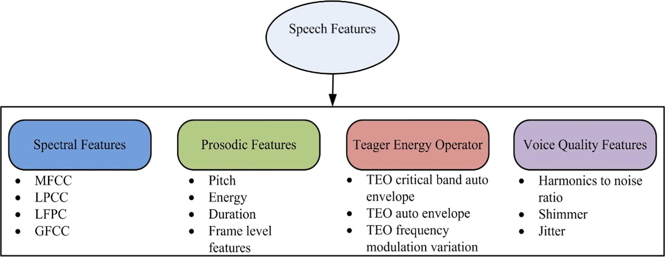
Speech Features

Slide 4



Python Package for Speech Signal Preprocessing
Librosa: Python library for audio and music analysis
TorchAudio: PyTorch 的音訊處理模組
如果要使用一些其他的語音特徵如: GFCC、LFPCs，從 github 找或用 SciPy 自己寫
SciPy: Fundamental algorithms for scientific computing in Python

Slide 5
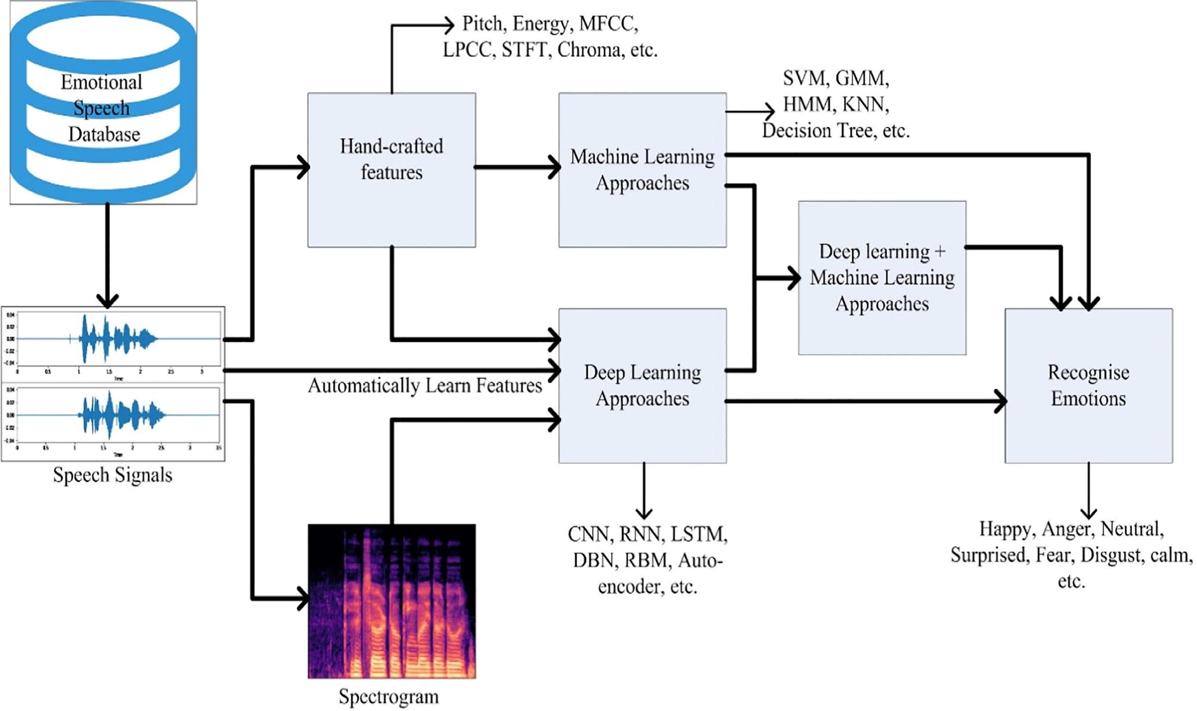
Processes in Speech Emotion Recognition (SER)

Slide 6
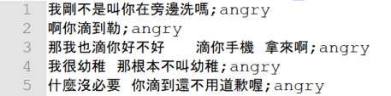
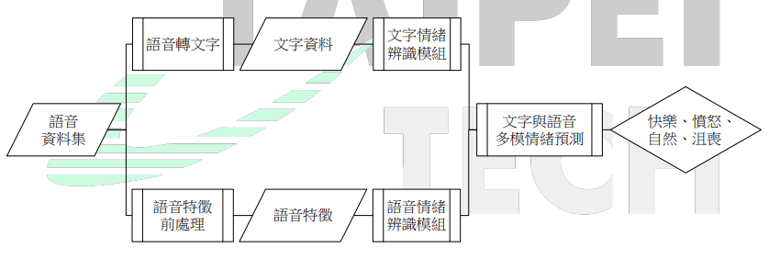
MultiModal Machine Learning in SER

Slide 7
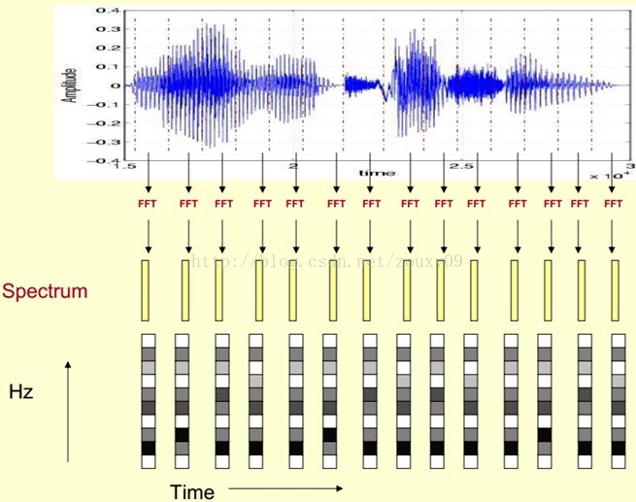
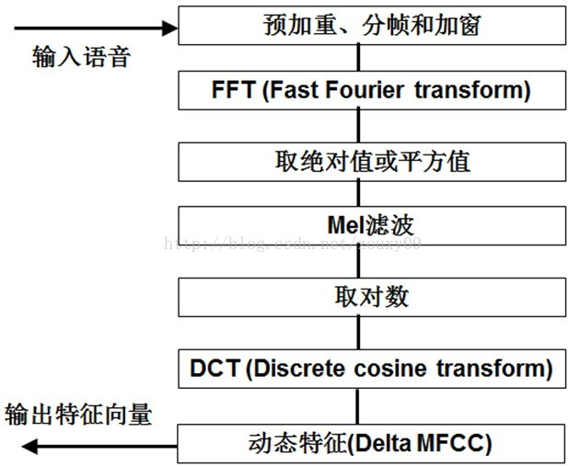
Mel-Frequency Cepstral Coefficients

